Slide 1
Definition of Multimedia
Multimedia is a combination of text, graphic, sound, animation, and video that is delivered interactively to the user by electronic or digitally manipulated means.
GRAPHIC
TEXT
MULTIMEDIA
VIDEO
AUDIO
ANIMATION

Slide 2
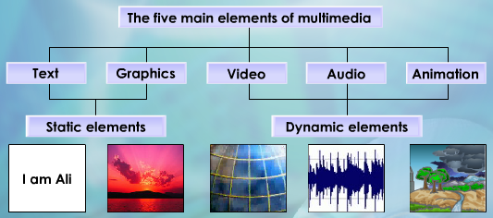

Slide 3
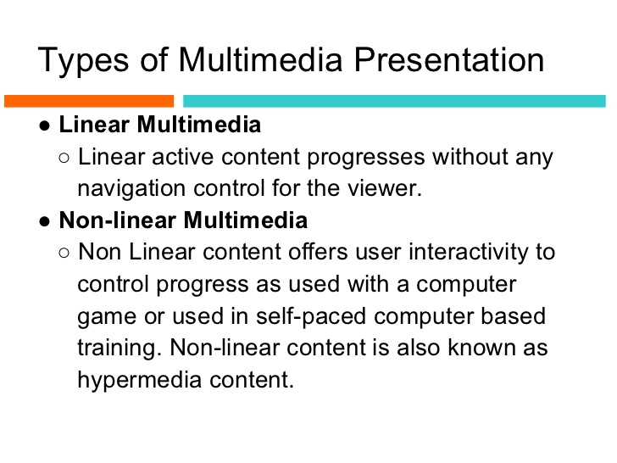

Slide 4
Linear and Nonlinear - Differences

Slide 6
Linear and Nonlinear Presentations - Differences

Slide 7
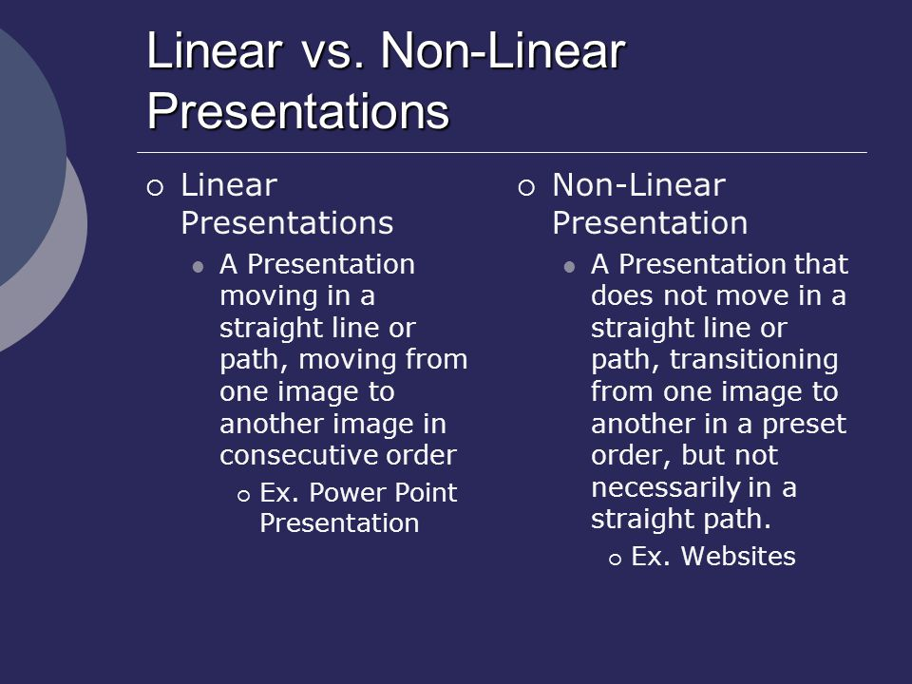

Slide 8
What is Hypertext

Slide 9
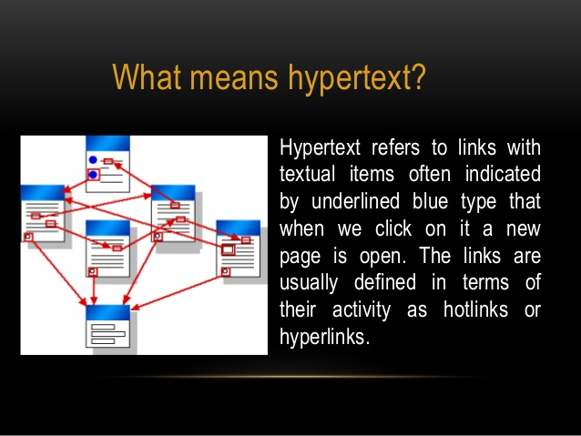

Slide 10
Multimedia Products
Briefing Products
Reference Products
Database Products
Education and Training Products
Kiosk
Entertainment and Games

Slide 11
Multimedia Products
Briefing Products
1
Small, straightforward, linear products used to present information quickly and concisely.
Characteristic of briefing product:
Short Development Cycle
Limited Number of Presentations
Usage of text to present information with limited use of graphic, audio and video.
Have few navigational controls. (mouse click and button press to move from one page to another)
Content and the format are suitable for the audience and fulfill the purpose of the presentation.
1/2

Slide 12
Multimedia Products
Reference Products
2
Good usability and success depends on:
The developers understanding the body of information and how the end user will want to access it.
Help function should always available to explain how to access and use the information
Examples are electronic forms of:
Encyclopedia
Dictionaries
Cookbooks, Historical, Informative
Scientific surveys.
2/2

Slide 13
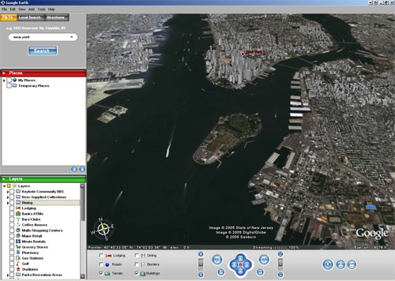
Multimedia Products
Database Products
3
Examples are:
Google Search
Google Earth
2/2

Slide 14
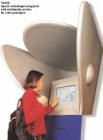
Multimedia Products
Kiosk Products
5
A product which is usually stationed at public places and allow the user to find information interactively and also other types of transaction.
Characteristics of Kiosk Products:-
Limited target users and usage.
User friendly and easily used by user.
Fast response.
1/2

Slide 15
Authoring Tools

Slide 16
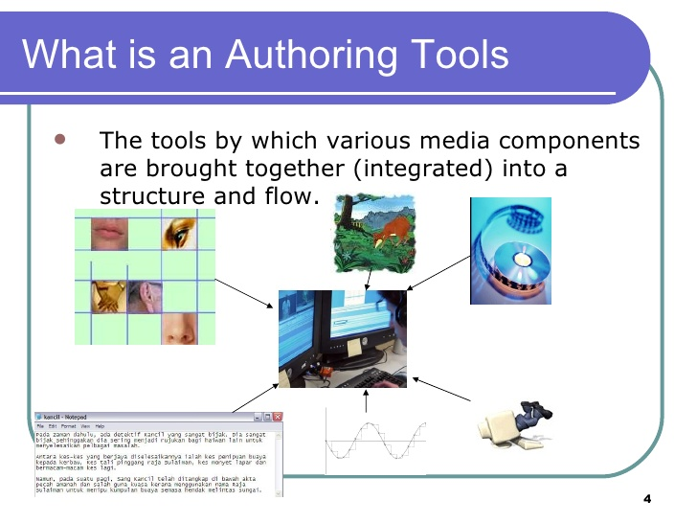

Slide 17
Functions of Authoring Tools
Use to merge multimedia elements (text, audio, graphic, animation, video) into a project.
Designed to manage individual multimedia elements and provide user interaction (if required).

Slide 18
Differences between- Bit Map and Vector Drawn Images

Slide 19
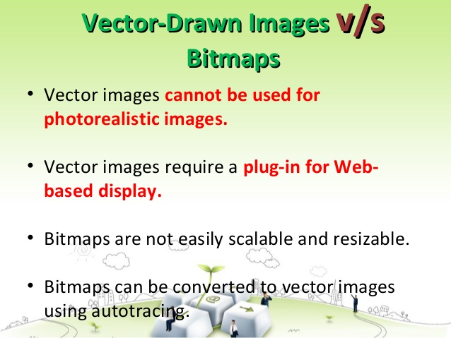

Slide 20
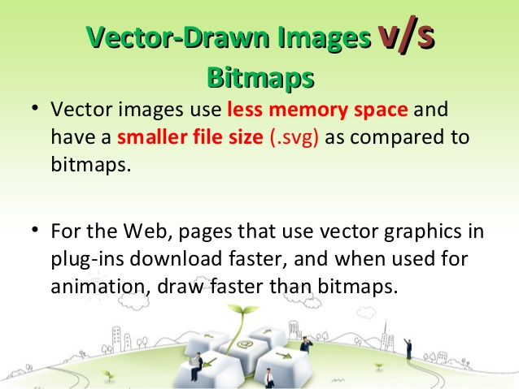

Slide 21
Dithering

Slide 22
Dithering
Dithering is a process where the color value of each pixel is changed to the closest matching color value in the target palette, using a mathematical algorithm
It “averages” the color over an area and is usually close to the original color
Dithering software is usually built into image editing and multimedia programs

Slide 23
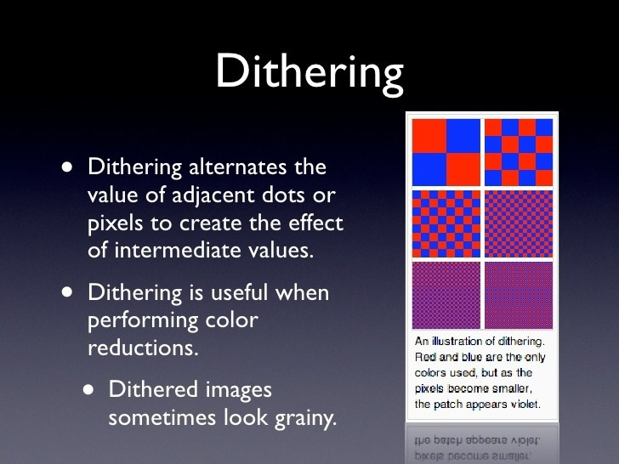

Slide 24
Sound Characteristics of Sound

Slide 25
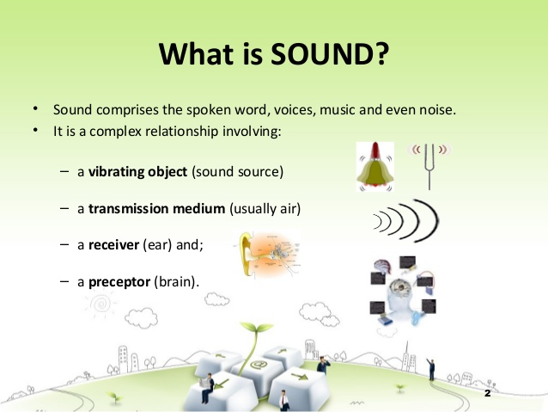

Slide 26
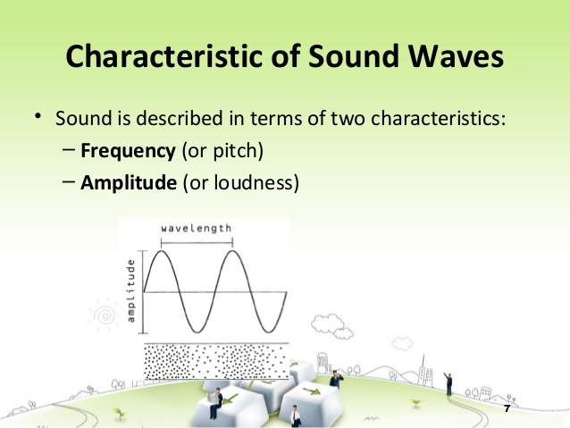

Slide 27
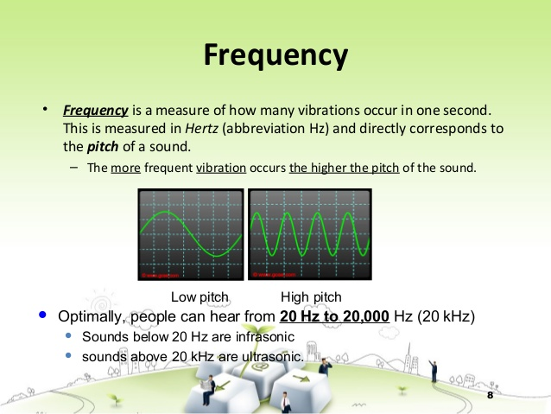

Slide 28
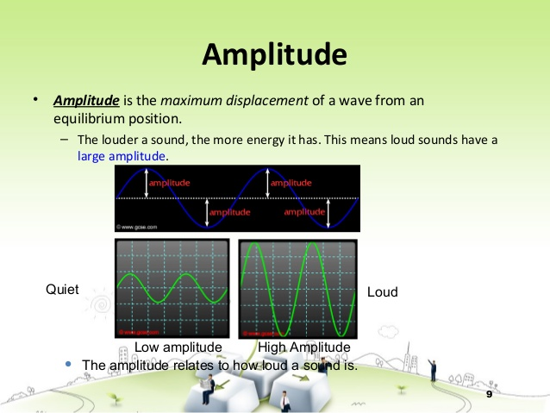

Slide 29
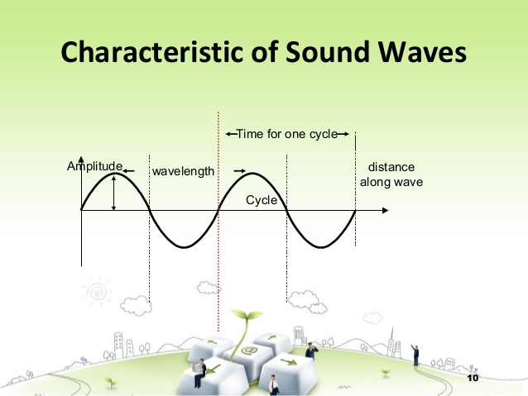

Slide 30
Analog to Digital Conversion Process

Slide 31
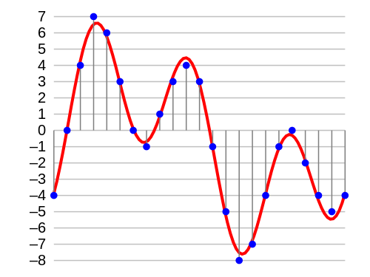
Procedure of audio digitalization
Analog Signal
Digital Signal
A/D ADC
D/A DAC
(Nature World)
(Computer)
Analog Signal
Digital Signal
Sampling
Quantization
Coding
conversion to a stream of numbers, and preferably these numbers should be integers for efficiency.
Notes:
Acoustical:听觉的，声学的A microphone converts the pressure waves of sound into voltage changes in a wire: high pressure becomes positive voltage, and low pressure becomes negative voltage.
When you record from a microphone into a computer, for example, analog-to-digital converters transform the analog signal into digital samples that computers can store and process.
Since we are interesting in working with such data in computer storage,we must digitize the analog signal produced by microphone. digitize means conversion to a stream of number.

Slide 32
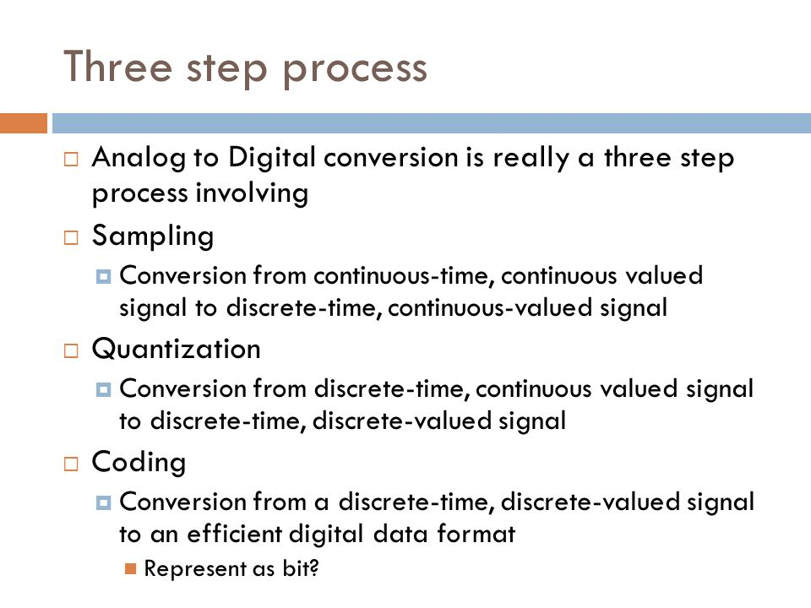

Slide 33
Applications of Multimedia

Slide 34
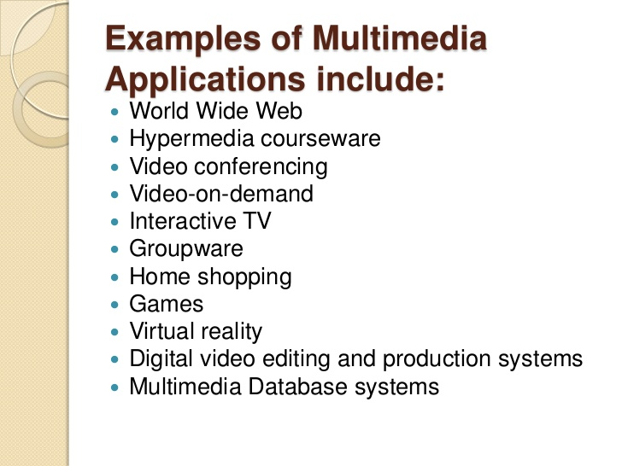

Slide 35
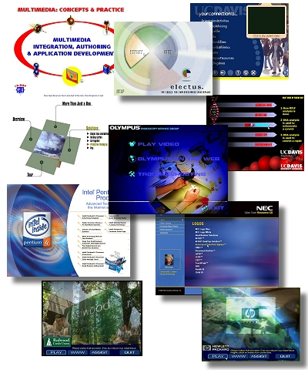
Applications of Multimedia
There are a number of fields where multimedia could be of use. Examples are:-
Business
Education
Entertainment
Home
Public Places

Slide 36
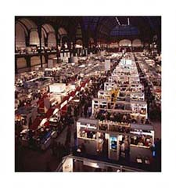
Applications of Multimedia
Business
Use and Applications
Sales / Marketing Presentation
Trade show production
Staff Training Application
Company Kiosk

Slide 37
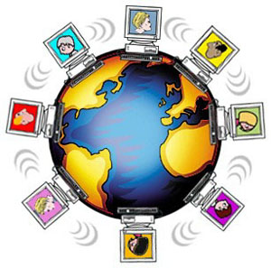
Applications of Multimedia
Education
Use and Applications
Courseware / Simulations
E-Learning / Distance Learning
Information Searching

Slide 38
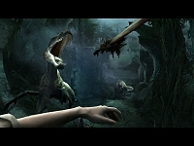
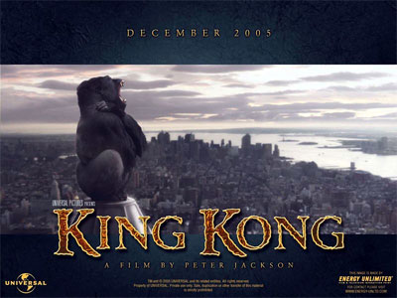
Applications of Multimedia
Entertainment
Use and Applications
Games (Leisure / Educational)
Movies
Video on Demand
Online

Slide 39



Applications of Multimedia
Home
Use and Applications
Television
Satellite TV
SMS services (chats, voting, reality TV)

Slide 40
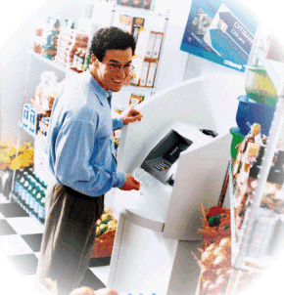
Applications of Multimedia
Public Places
Use and Applications
Information Kiosk
Smart Cards, Security

Slide 41
Define Bit map
What type of images does bitmap Apply?

Slide 42
Bitmaps
Bitmapped images are known as paint graphics.
A bitmap is made up of individual dots or picture elements known as pixels or pels.
Bitmapped images can have varying bit and color depths.

Slide 43
Bitmaps
Bitmaps are an image format suited for creation of:
Photo-realistic images.
Complex drawings.
Images that require fine detail.

Slide 44
How Vector drawn Images Work

Slide 45
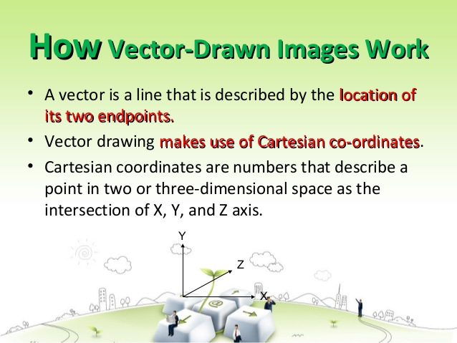

Slide 46
